Slide 1
Health Insurance Analysis and Prediction price using ML model
Abstract:- This Project is for the doing the basic exploration and analysis for the Corona data set and predict the corona positive or negative using various ML model and finding the best model for the prediction.
From :-Lokesh R
BE Graduate (AE)
Aspiring Data scientist

Slide 2
Prediction of the corona is very important because predicting the corona positive correctly is will help the health care system to make there operation effectively.
The number of correct prediction will help the hospitals will help in tracing the positive person and will help the in reducing the rick of getting dangers health issue or death and avoiding the spreading of corona to other people by proper tracking .This the main reason why predicting the positive person is very importance.
The dataset which was taken for the analysis is from Kaggle:-
“kaggle kernels output mykeysid10/detection-of-covid19-cases-using-ml -p /path/to/dest”
The Data set consist of missing values which was imputed using the suitable techniques.
The Data set consist of all categorical values which was encoded with the suitable techniques.
The Dataset was an supervised classification model which means the output variable was given and the outcome variable was categorical.
For the exploration of the data was done by using the python libraries like Numpy (For numerical operation),Pandas(For Dealing with the Data Set), Matplotlib(For plotting graph), seaborn(Data visualization ), plotly(For data visualization),and sklearn (For Feature Engineering and Machine learning ).

Slide 3
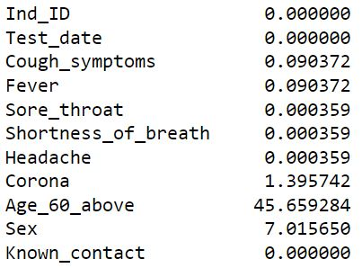
The first part of the project was to deal with missing values so to out missing values and any wrong entry pandas library was use and to impute the missing value simple imputer was use because data set imputed by this method was showing good accuracy compare to other method.
From the image we can see that there are some missing values which are imputed using simple imputer category method.
Because the values all are category so there is no outliers to deal with but because its an categorical value they should be encoded accordingly to go for ML algorithms.
There are 3 types of encoding which are
1)Binary encoding.
2)Ordinal encoding.
3)Categorical encoding.

Slide 4
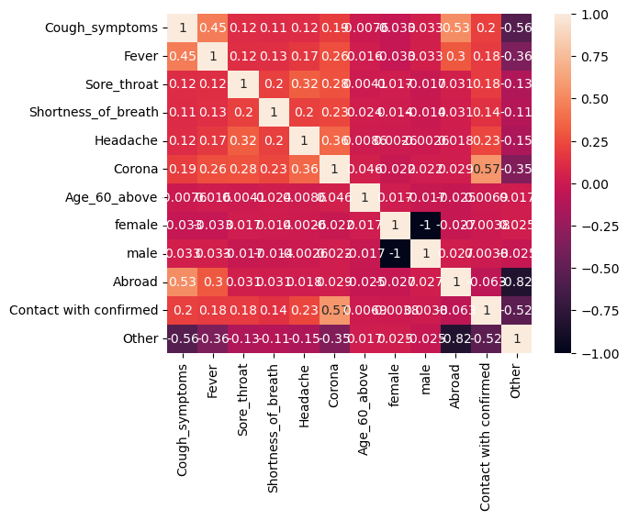
Hypothesis testing:-
From the above heatmap we can see that there is no correlation among the variable which must be the assumption that should be a good assumption for logistic regression.
Because the variables are categorical variable so there can be linear relation among them.
So logistic regression can be used for the prediction of the outcome variable.

Slide 5
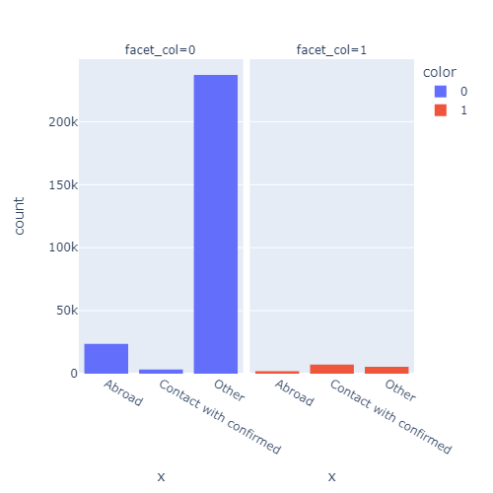
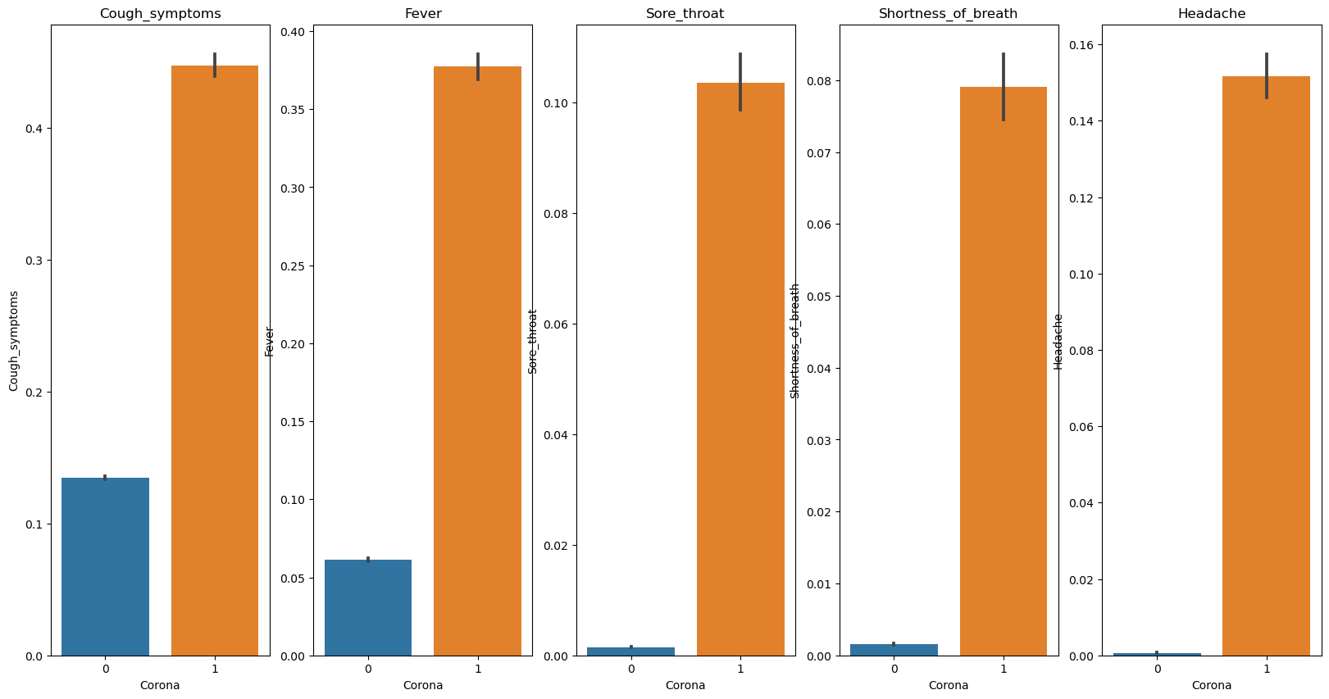
EDA:-
From the plot we can see that there are large number of negative people and the positive rate is high for the contact with confirmed
From the plot we can see that the most common symptom are cough and fever shortness in breath is least symptom found in the covid positive person and cough is also the common symptom found in covid negative person also

Slide 6
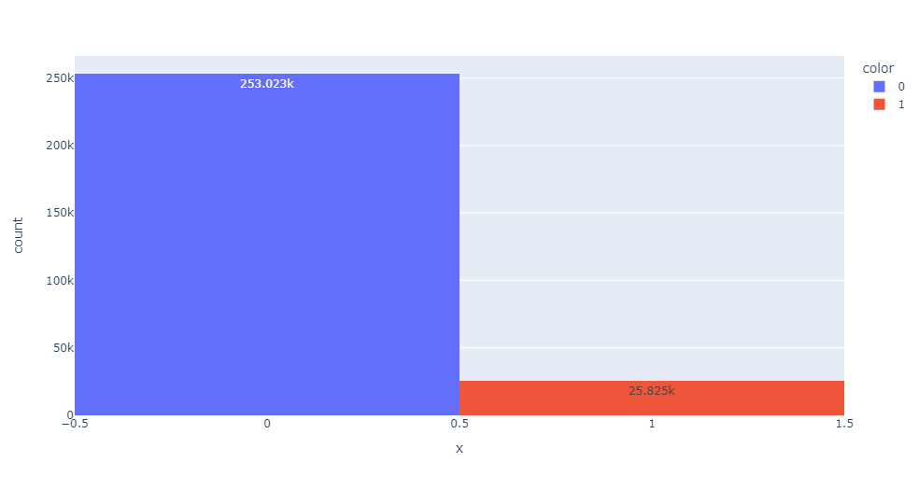
From the above exploration we can say that classification model should be used for the prediction of the covid and there are some many model by which we can predict the outcome.
Some of the models are:-
1)Logistic Regression.
2)KNN.
3)SVM.
4)Decision tree.
5)Random forest.
6)XGBoost.
Form the plot we can see that there are 25.8k persons are positive how are above 60

Slide 7
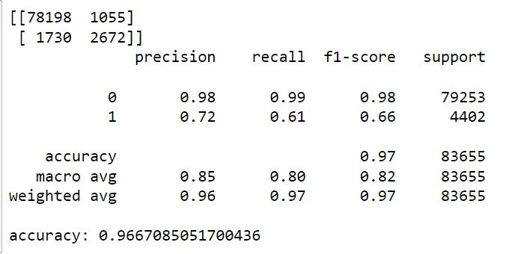
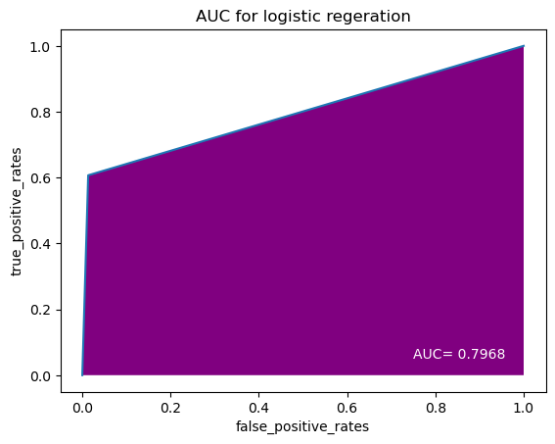
1)Logistic Regression:-
LGR(C=0.0001,penalty='l2',solver='liblinear')
where C= inverse of regularization strength, Penalty =regularization and solver = algorithm to use.
For the verification of the classification model we can use confusion metrics , AUC curve, accuracy, precision and recall .

Slide 8
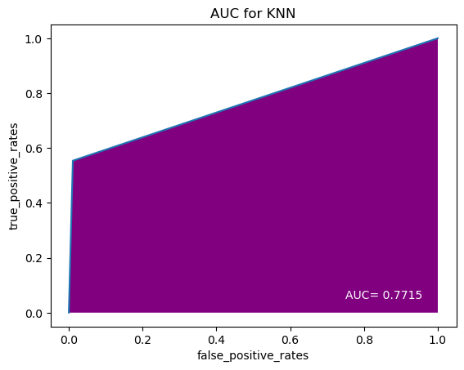
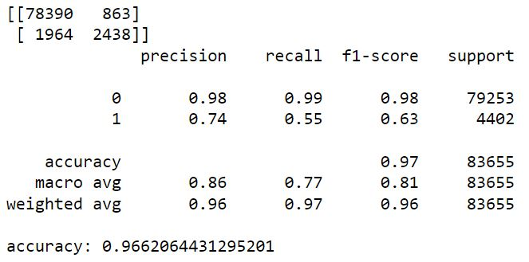

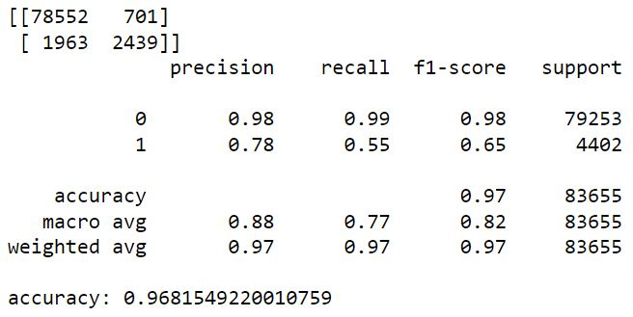
2) K Neighbors classifier:-
KNeighborsClassifier(n_neighbors=5,algorithm='auto')
3) Support Vector machine:-SVC(C=1.0,kernel='rbf',degree=3)
Where c=Regularization Parameter,kernel =dividing plan

Slide 9
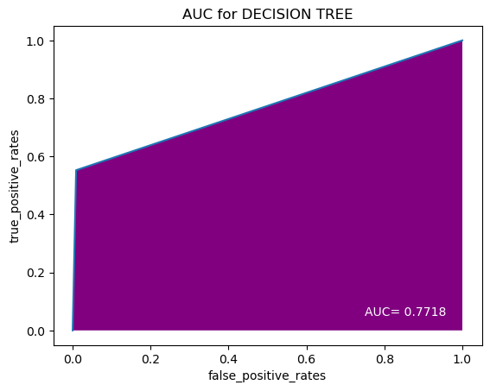
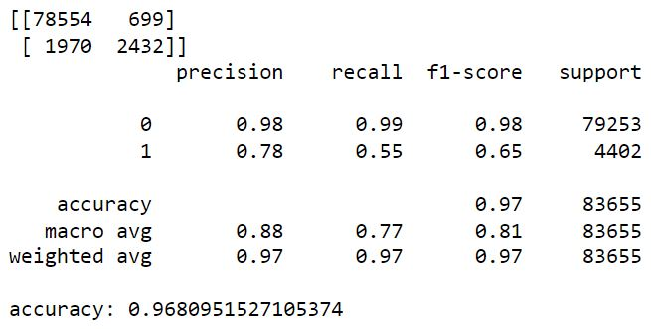

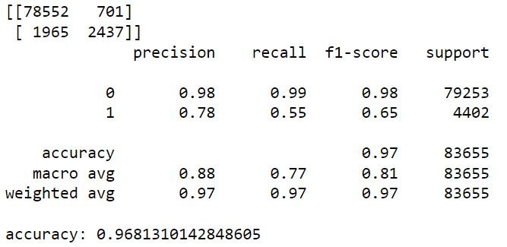
4) Decision Tree Classifier:- (criterion='entropy',max_depth=9,splitter='random').
Criterion =selecting the variables from data ,max_depth =number of trees
5) Random Forest Classifier :- (max_depth=9,n_estimators=50)
n_estimators=fitting of the model .

Slide 10

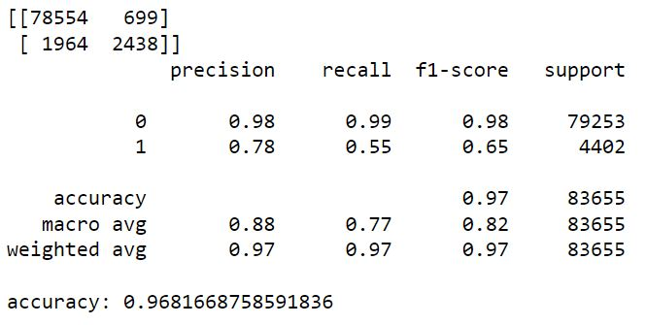
XGBoost :-(max_depth=9,n_estimators=20).
Here estimators is number of trees
Conclusion :-
From the above data frame we can see that all the model are giveing almost same kind of accuracy which is around 96% and the max accuracy was found in the decision Tree and support vector machine which is around 96.81%.

